Slide 1
BBD 2023 Lightning Talks
This slide deck contains the slides used in the Bridging Big Data 2023 Workshop.
Note that the name title slides have been removed for conciseness.
Note also that some of the posters were updated after they were added here.

Slide 2
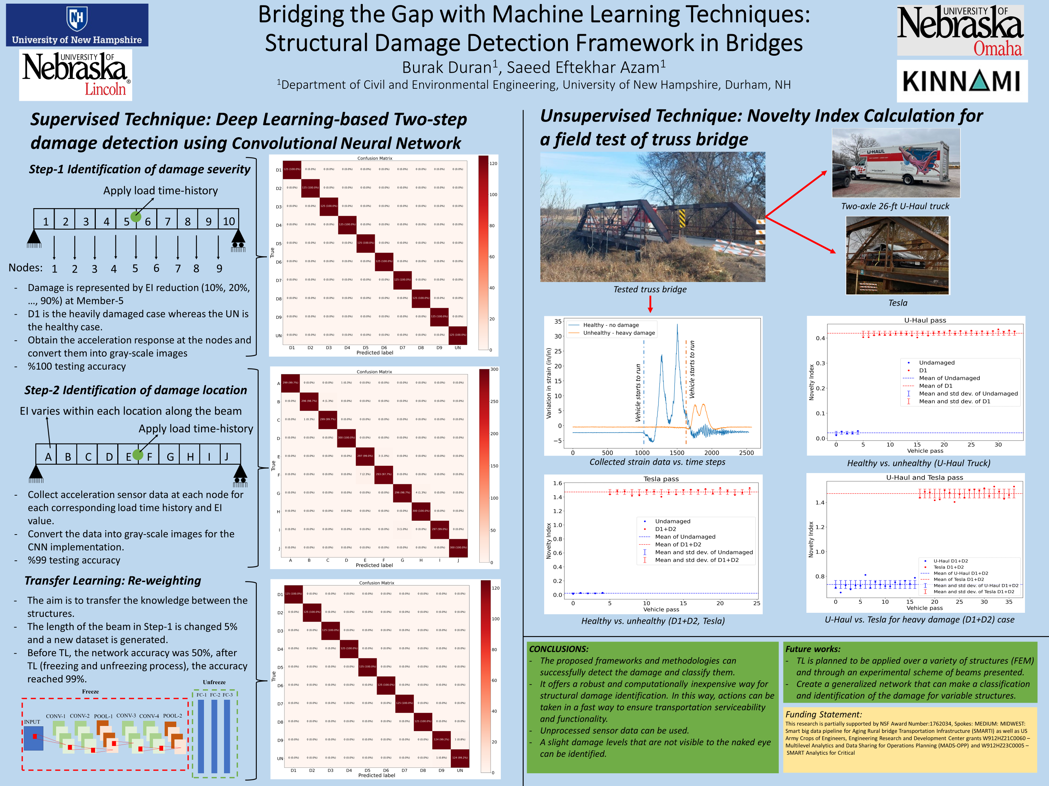

Slide 3


Slide 4
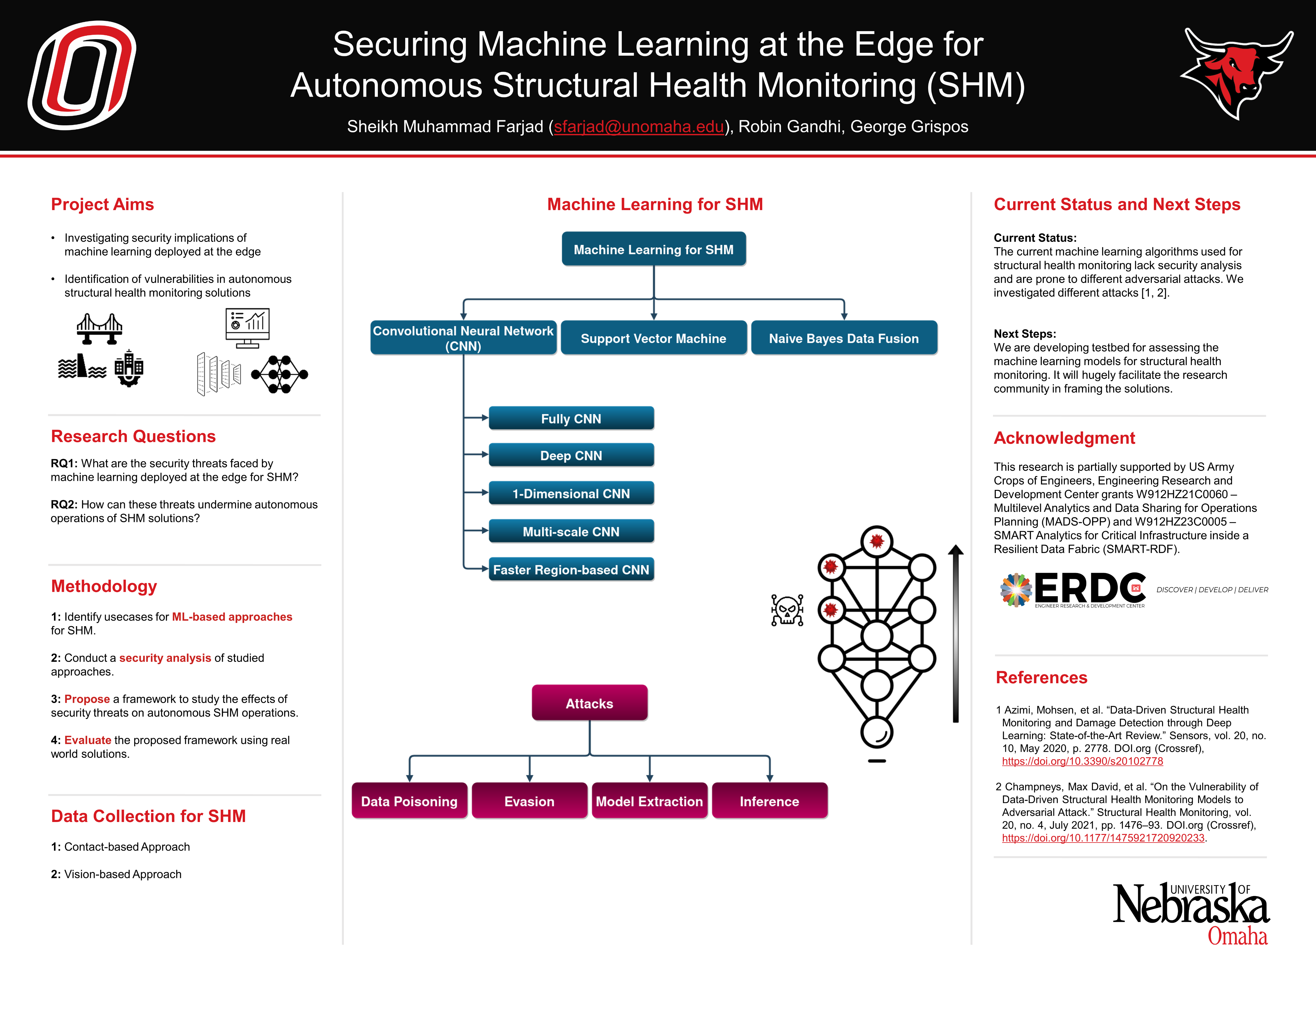

Slide 5
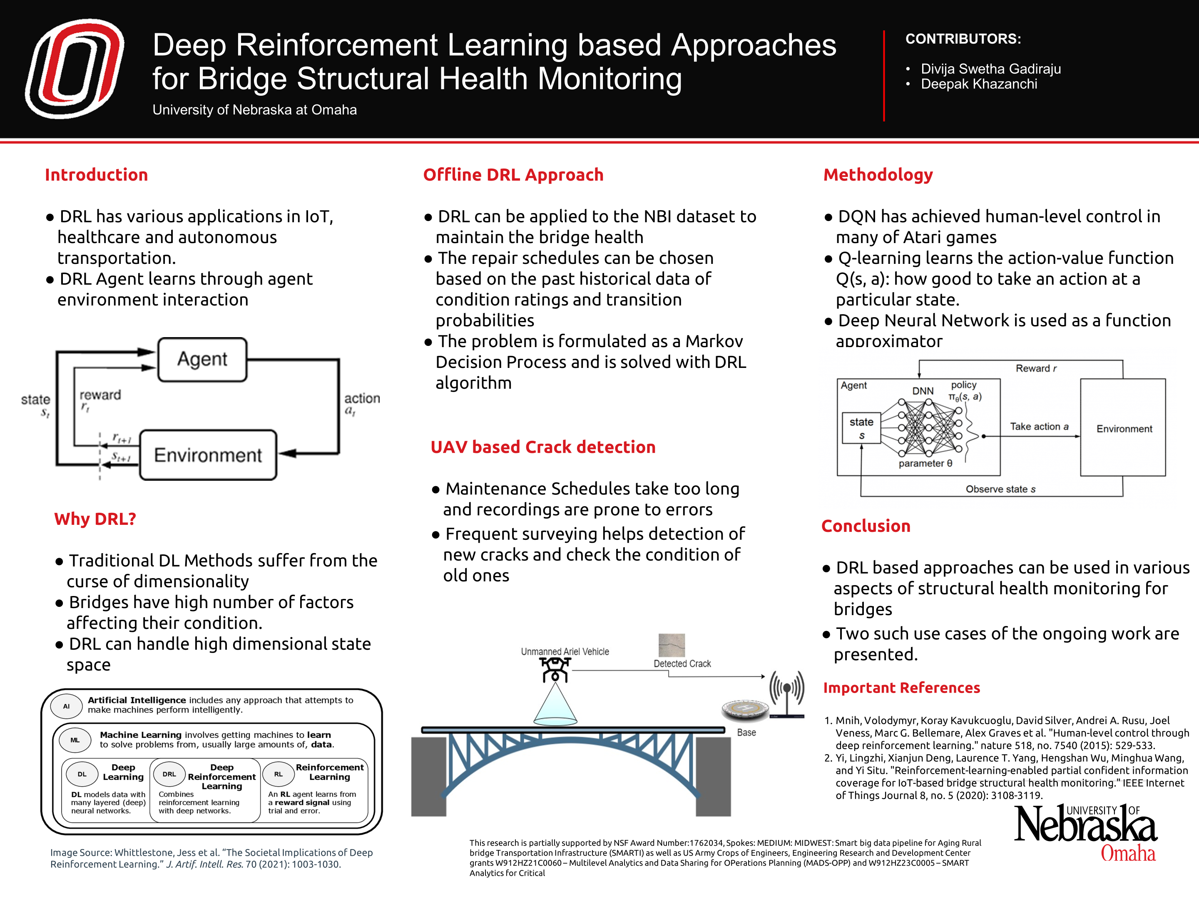

Slide 6
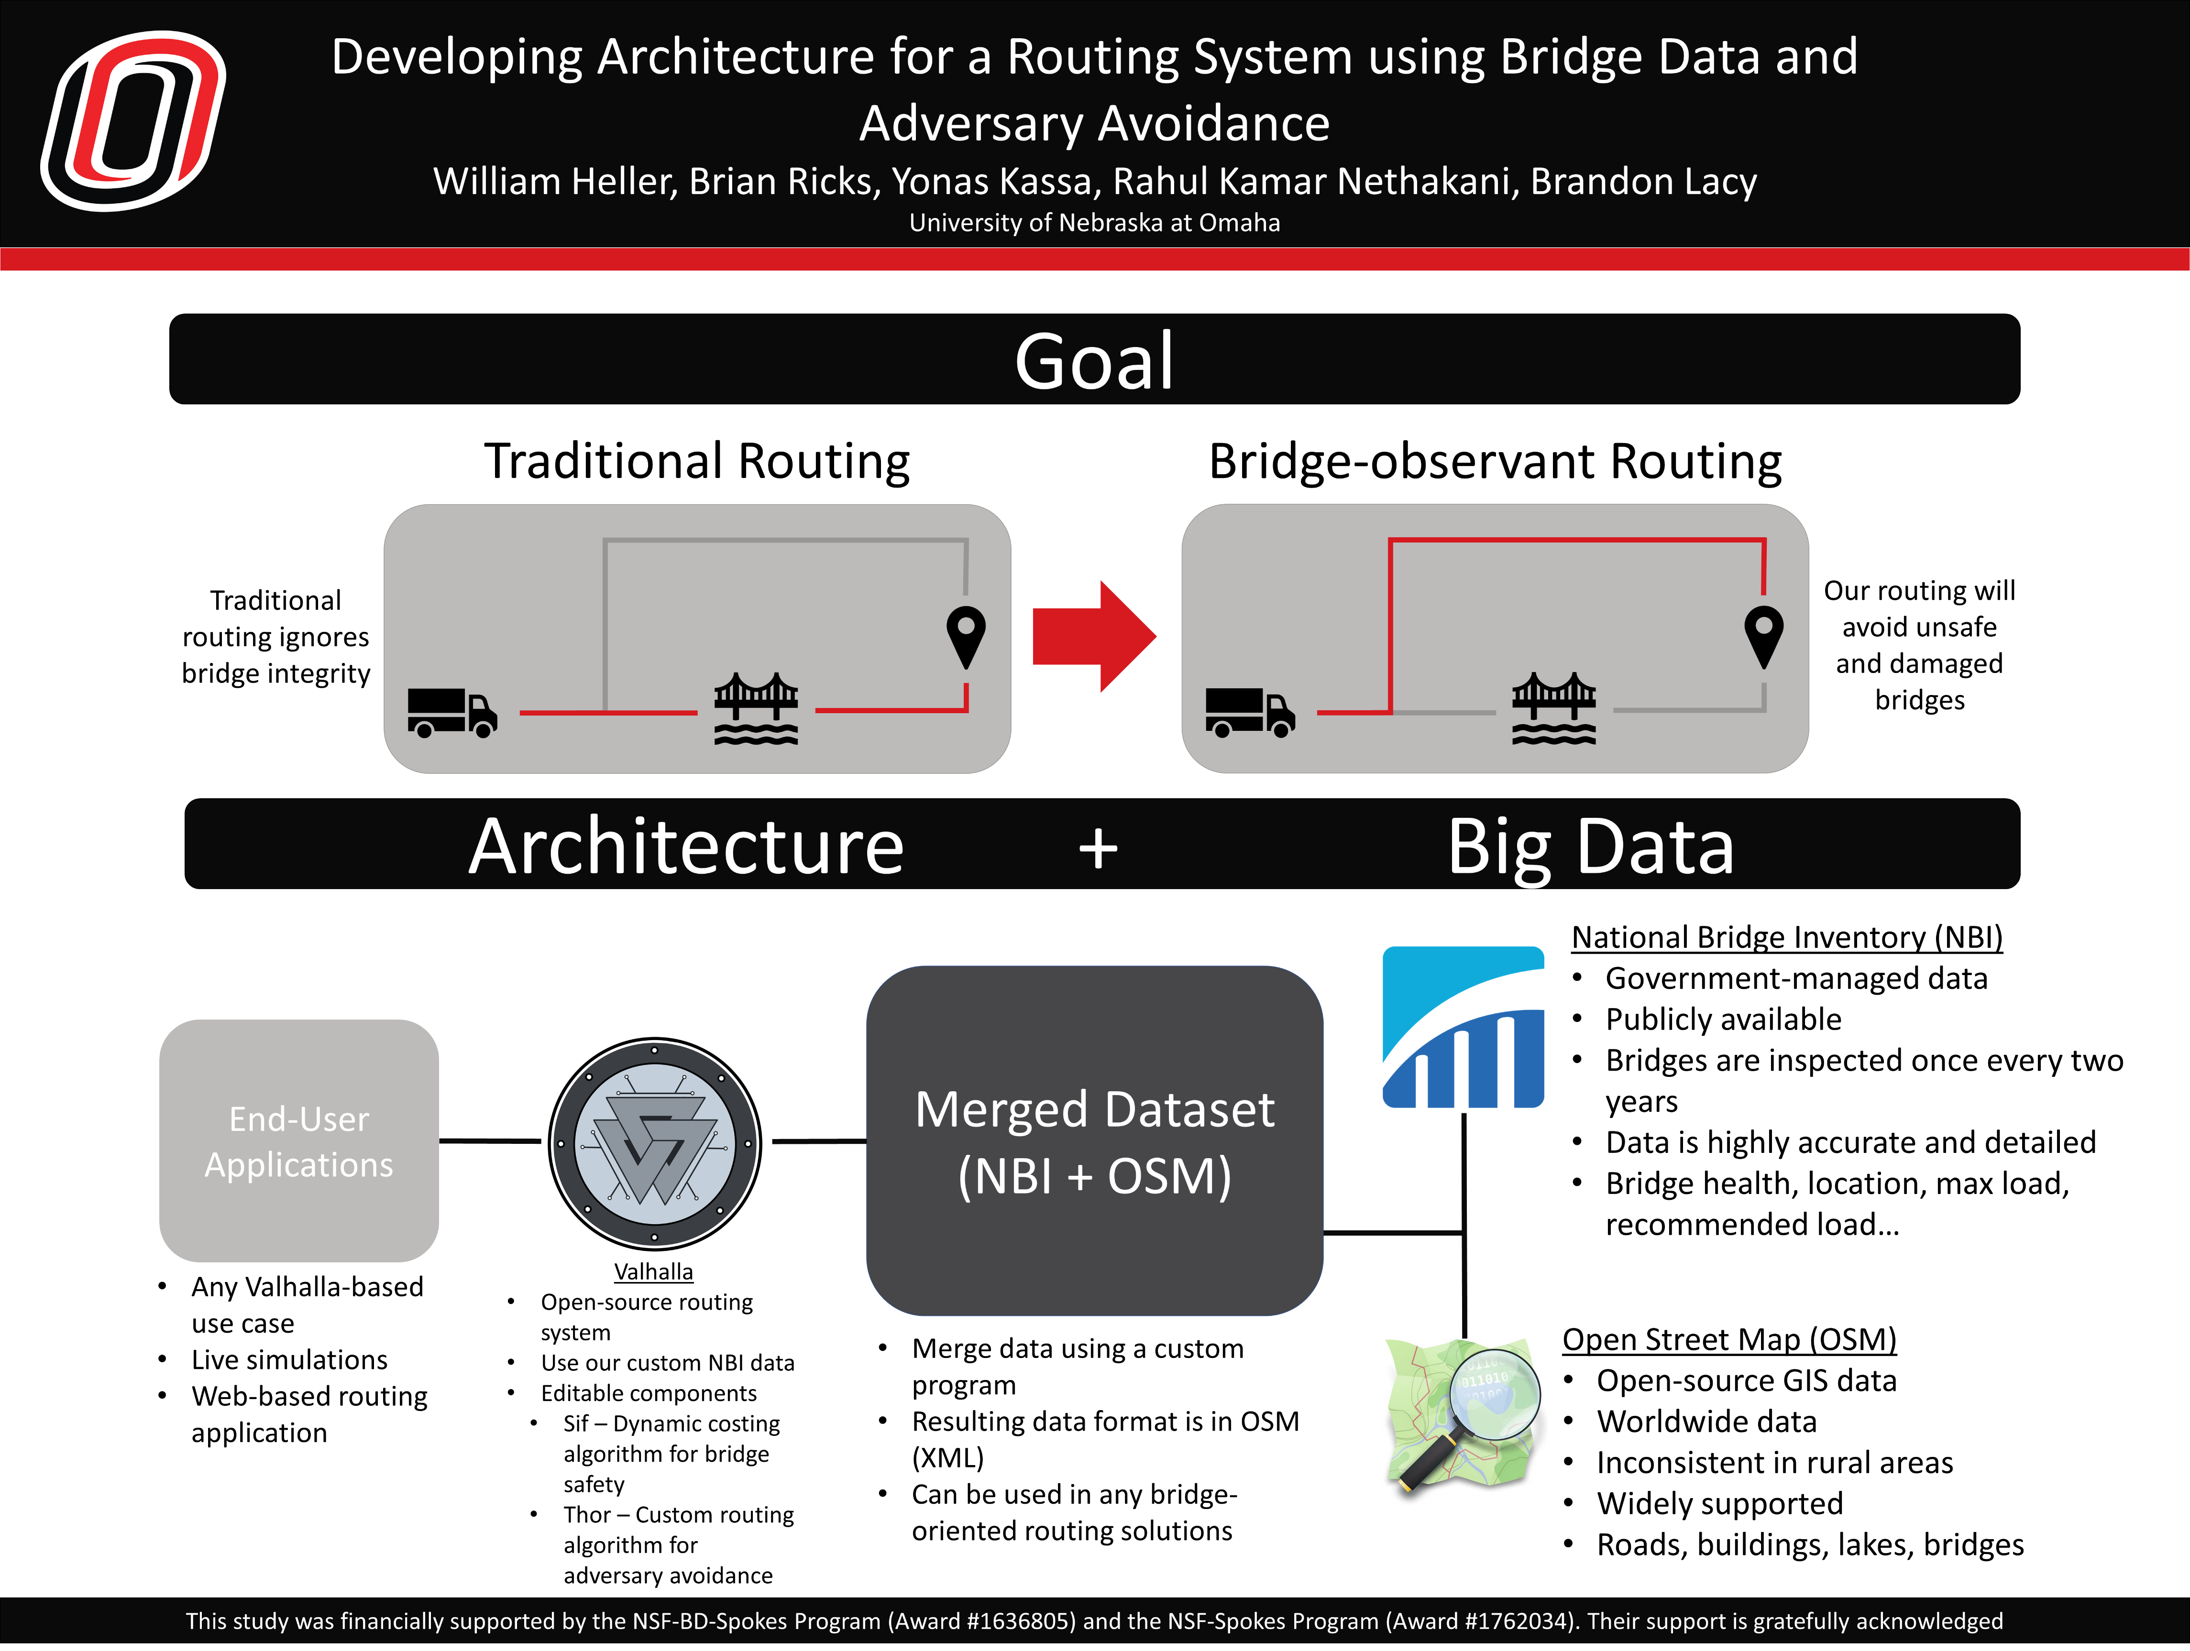

Slide 7


Slide 8
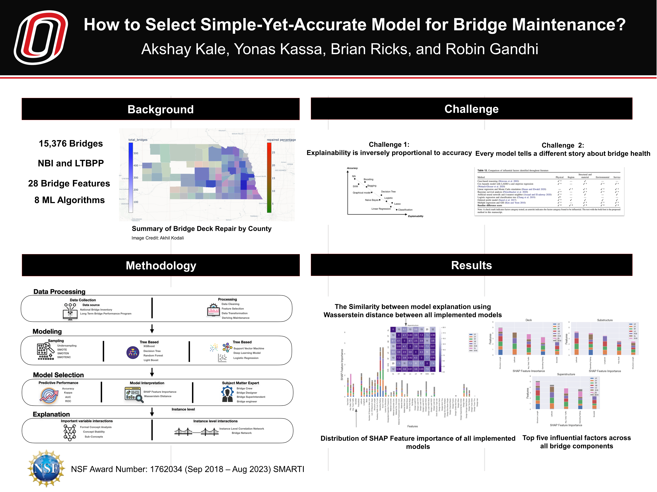

Slide 9


Slide 11
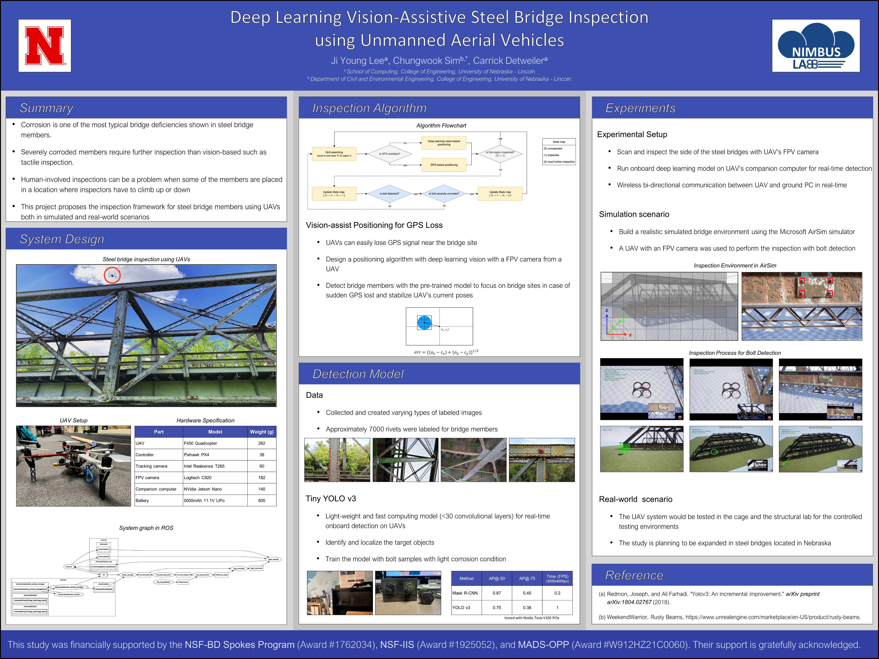

Slide 12
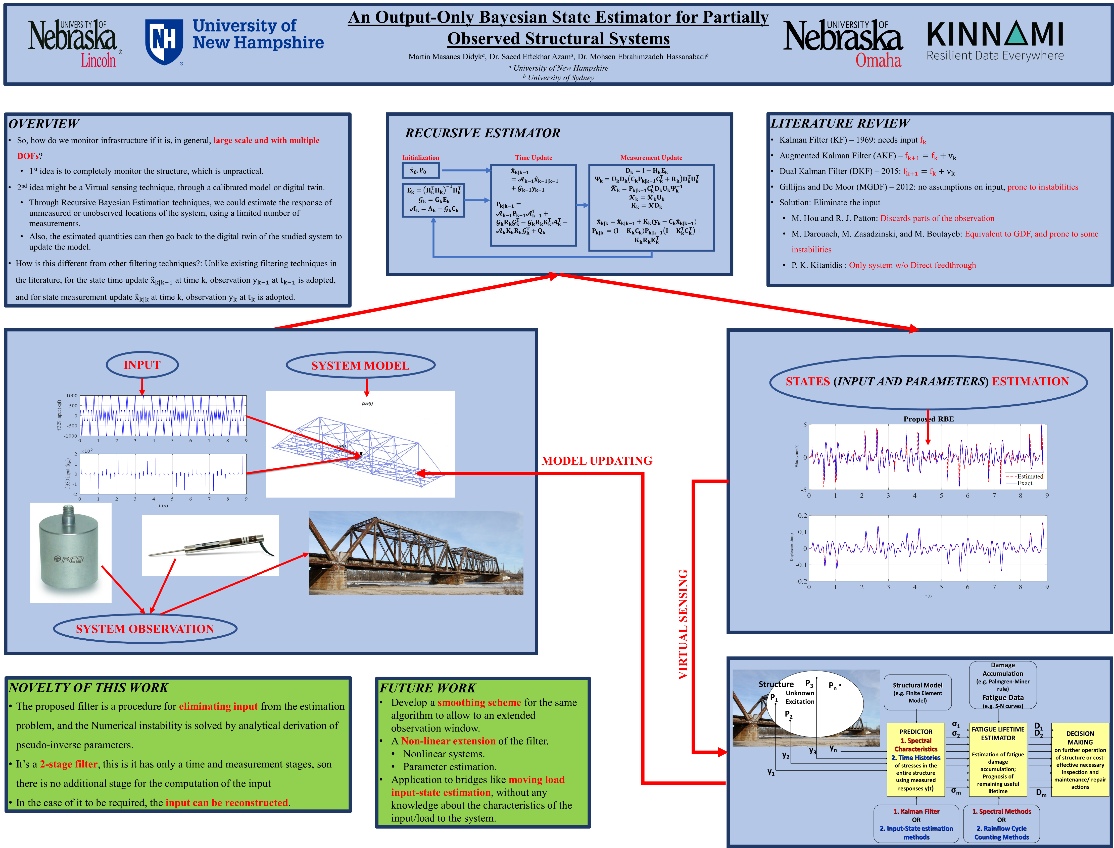

Slide 13


Slide 15


Slide 16
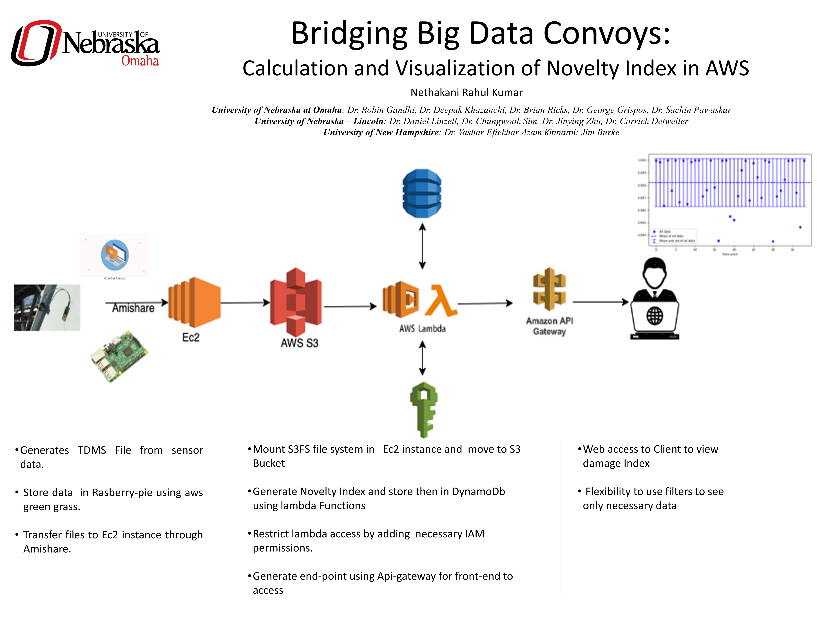

Slide 17
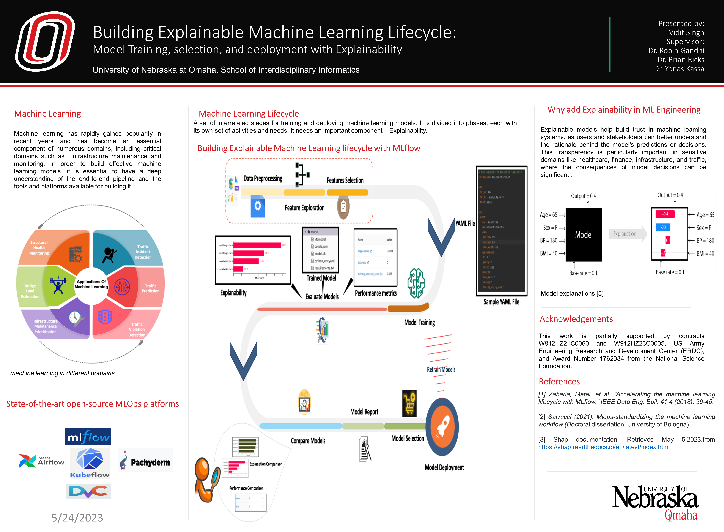

Slide 18
Progress in a New Visualization Strategy for ML Models
CONTRIBUTORS:
Alex Wissing
Dr. Brian Ricks
Dr. Robin Gandhi
Dr. Yonas Kassa
Akshay Kale
A Mid-Project Summary of Design and Ongoing Problems
University of Nebraska at Omaha, College of IS&T
Background
Visualization
Design
Challenges
Overview of ML Models
Machine Learning Models are trained on datasets which are encoded into numbers. The models are then evaluated for effectiveness, eventually yielded a model which can somewhat accurately make predictions based on correlations from the input.
Machine Learning Models take a set of features, or categories of data, and encode them into numbers; a model then is able to be sent information to make predictions. After a prediction is made, it must be interpreted via decoding. This then leads to a result.
Main Idea
This visualization strategy takes two selected features and draws a graph with the model’s output embedded in a color gradient.
At a coordinate (feature 1, feature 2), the model can be ran by generating random, acceptable values for additional features. The model is polled a number of times, each time with the selected features remaining the same, but other features randomly generated. Model output is aggregated in a arithmetic mean value.
This mean value is used as the third dimension in the graph, the color gradient.
Achieving linguistic performance and memory control when models originate from Python-based Tensorflow programs
Resolved with the frugally-deep github repository and using C++ to generate visualization data
Learning about ML and how it’s organized just before and just after a prediction is made
Talking with my team members and experimenting with the model in Python and C++ has given me a better understanding of machine learning
.Managing different types of input (Discrete vs Continuous)
An incremental approach was used to explore the continuous space, represented using floating-point values. The discrete values are only calculated once if not matched with a continuous, saving runtime
Work In-progress
Incremental Variance Algorithm alongside arithmetic mean
Expanding visualization technique beyond binary models
Managing inter-feature constraints during random generation and feature selection
Usage of this visualization technique to explore a model trained on the Iris dataset
Usefulness of Visualization
Explores Model’s Learned Boundary Lines
Decision Tree models create linear, single-axis boundaries, but most other models, including deep-learning models create non-linear boundaries. The goal of this visualization is to find and show those boundary lines as they exist in a relation between two features.
Acknowledgements
This research is partially supported by NSF Award Number:1762034, Spokes: MEDIUM: MIDWEST: Smart big data pipeline for Aging Rural bridge Transportation Infrastructure (SMARTI) as well as US Army Crops of Engineers, Engineering Research and Development Center grants W912HZ21C0060 – Multilevel Analytics and Data Sharing for OPerations Planning (MADS-OPP) and W912HZ23C0005 – SMART Analytics for Critical Infrastructure
Visualization
D3.js is used to create a heatmap, a cell a coordinate whose color is determined by a linear interpolation along a gradient using the mean.
The above graphic shows a model deciding whether it will rain or not given recent amount of rainfall, wind speed, and the current whether condition.

